Slide 1
AWS Lambda with Serverless
Korey Kolberg
Consultant, Slalom

Slide 2
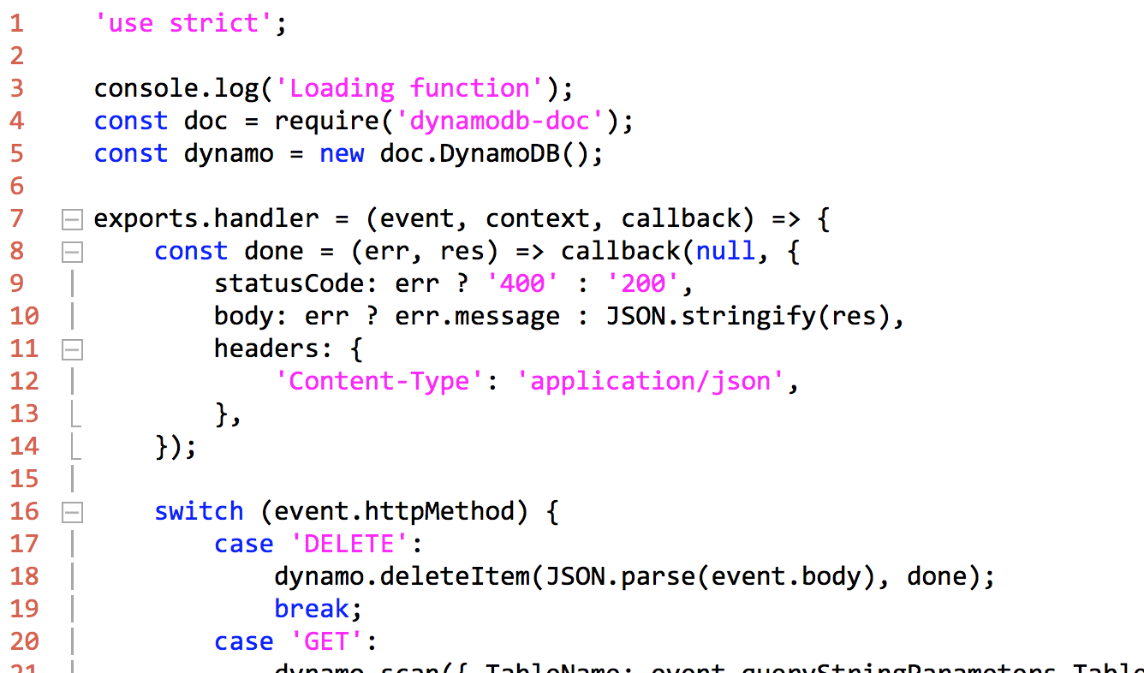
Sample lambda

Slide 3
Entry point
exports.handler = (event, context, callback)
event – data payload
context – runtime information
callback – used to return data. Note: Always use callback(err, data) pattern.

Slide 4
Local Dev Setup
Npm – package manager
Nodejs – js server framework
Serverless – lambda framework
Mocha – testing framework
Istanbul – unit test coverage framework
Aws cli – commandline aws tools
Git – source control

Slide 5
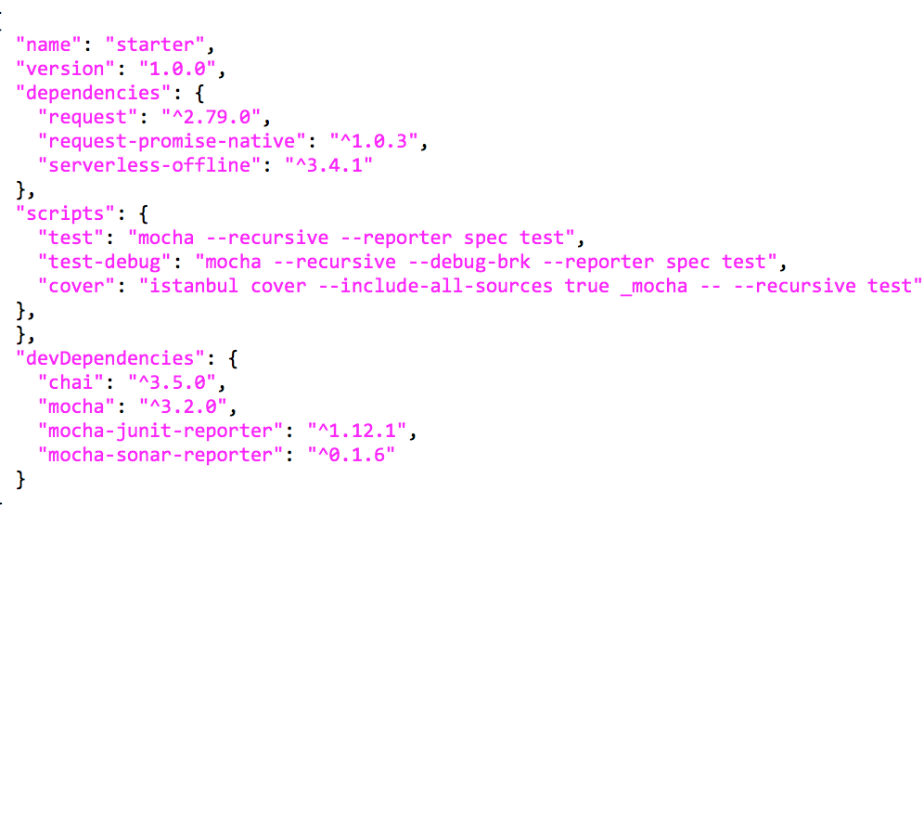
NPM
npm install –g <package>
npm install <package> --save
npm install <package> --save-dev
npm run <command>

Slide 6
JavaScript
Do not pollute global scope
Function scope and hoisting (var vs let)
== vs ===
Duck typing

Slide 7
Nodejs
Callbacks
- Convention is to use function(err, data). If err is not null, error handling logic. Otherwise continue with data.
Promises
- A way to avoid callback pyramid. Instead of callback(err, data) you have .then(functionSuccess, functionFailure). These are chainable.
Modules
- A way to organize your code in small, reusable pieces.
Dependencies
- require(‘path’).

Slide 8
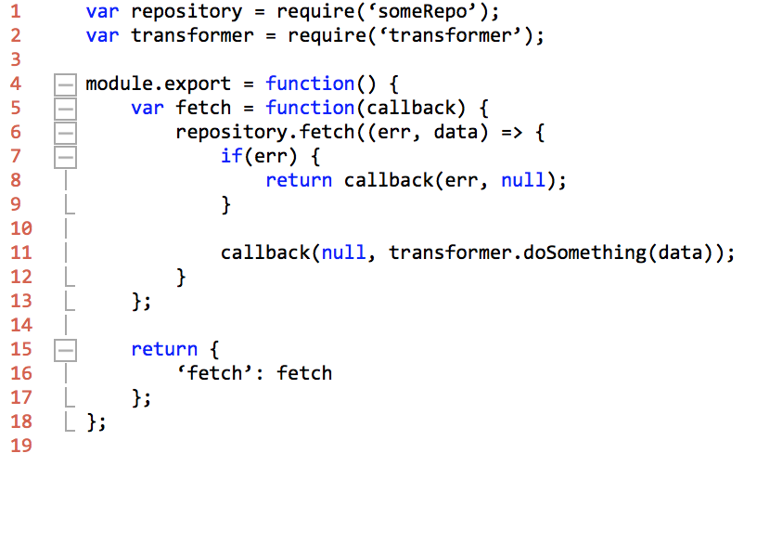
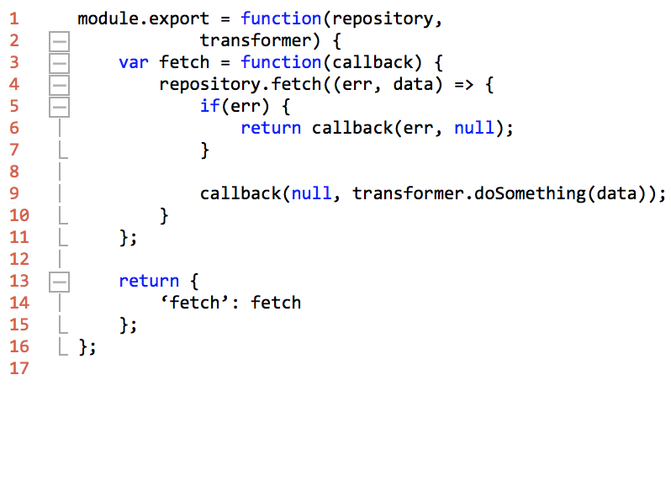
Dependency Injection
Inversion of control – framework hands dependency to your code vs you directly creating it yourself.
Why? Flexibility and testability

Slide 9
Serverless
Framework and cli to help manage aws infrastructure and code.
Allows easy local debuging via serverless-offline plugin
Uses yml file for configuration
Service
Think of this as a complete micro service
A group of related functions
Function
AWS Lambda
Responsible for doing one thing well
Entry point is exports.handler = (event, context, callback)

Slide 10
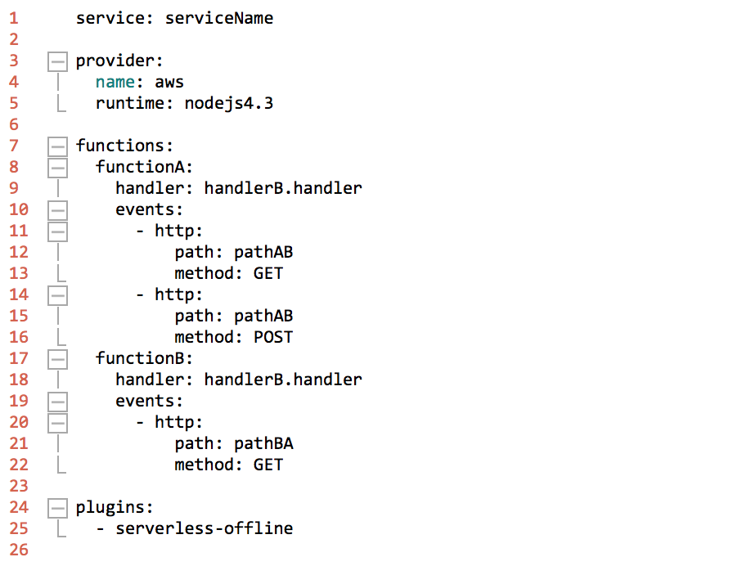
serverless.yml

Slide 11
Serverless commands
sls create --template aws-nodejs --path <myServiceName>
sls offline
node --debug `which serverless` offline start
sls deploy --stage-dev

Slide 12
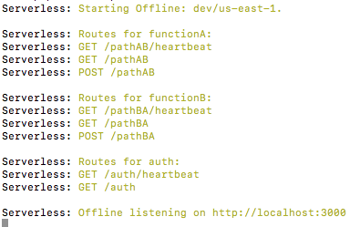
sls offline
Can use postman to call the endpoints listed.
Ex. GET on http://localhost:3000/pathAB/heartbeat

Slide 13
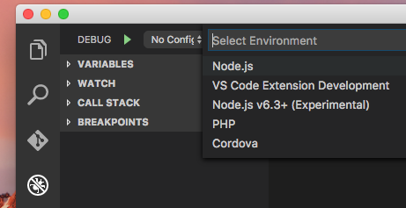

Debugging with Visual Studio Code
Put a break point in your code
Configure debugger (creates .vscode/launch.json)
node --debug `which serverless` offline start
Attach to Process
Call lambda

Slide 14
Testing
Test Driven Development:
Write test
Run tests
Fix broken tests
Repeat (Green, Red, Green, etc)
Unit test:
Test one thing at a time, one unit of code
Inject mock dependencies to remove unnecessary complexity
A living documentation of how the code should behave

Slide 15
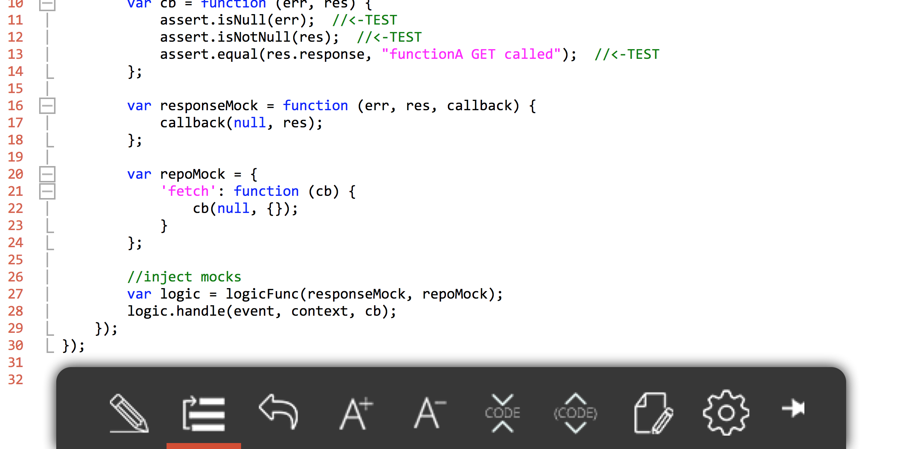
Mocha and Chai
Mocha is a testing framework and Chai one of the many assertion libraries.

Slide 16
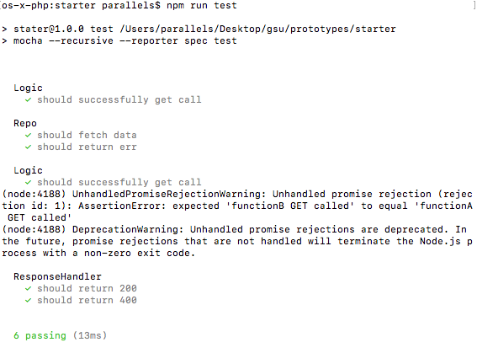
Mocha output
Run tests with:
mocha --recursive --reporter spec <path>

Slide 17
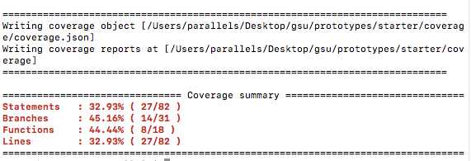
Code Coverage
What should be covered by tests? As much as you can. Focus on the core business logic.
Istanbul – tool that generates a code coverage report. Run with:
istanbul cover --include-all-sources true _mocha -- --recursive test

Slide 18
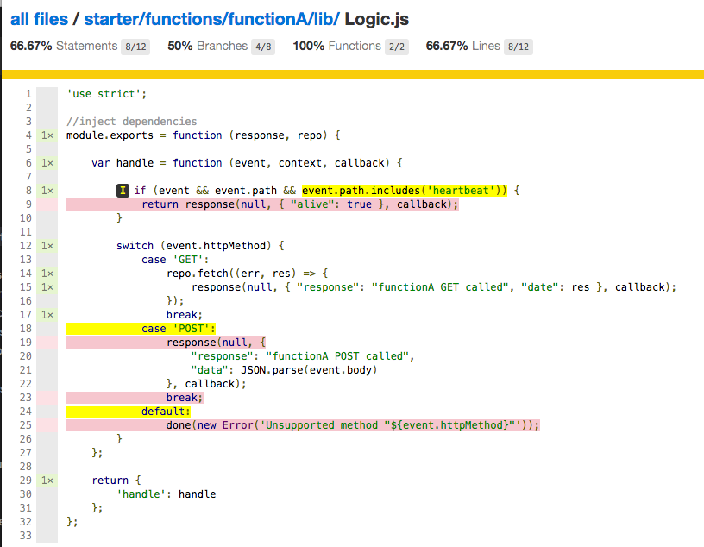
Html report

Slide 19
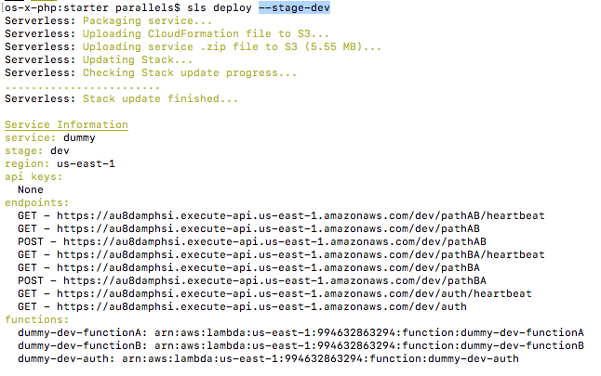
sls deploy

Slide 20
Questions?

